Slide 1

Phonics Read, Write, Inc
St Matthews CofE Aided Primary School
10th September 2025

Slide 2
What is Phonics?
Children are taught to read by breaking down words into separate sounds or ‘Phonemes’. They are then taught how to blend these sounds together to read the whole word.
Children have a 40 minutes phonics lesson each day and they are encouraged to use the strategies taught in these session to read and write in other lessons.
Phonics approaches aim to quickly develop pupils’ word recognition and spelling through develop their ability to hear, identify and use sounds.

Slide 3

Read Write Inc
As a school we follow the Ruth Miskin Read Write Inc scheme (RWInc)
The aim of RWInc is for all children have completed it by Autumn term of Year 2 and become fluent readers.
Children will learn –
All 44 sounds and the corresponding letters / letrer groups, using picture prompts.
To read words using sound blending know in RWInc as ‘Fred Talk’

Slide 4
Read Write Inc
Before your child can start to read, they need to learn how to –
Say the sound that is represented by each letter or groups of letters, these are called ‘Speed Sounds’.
Also how to blend the sounds together in a word to read it e.g. c-a-t = cat, this is called ‘Blending’.

Slide 5
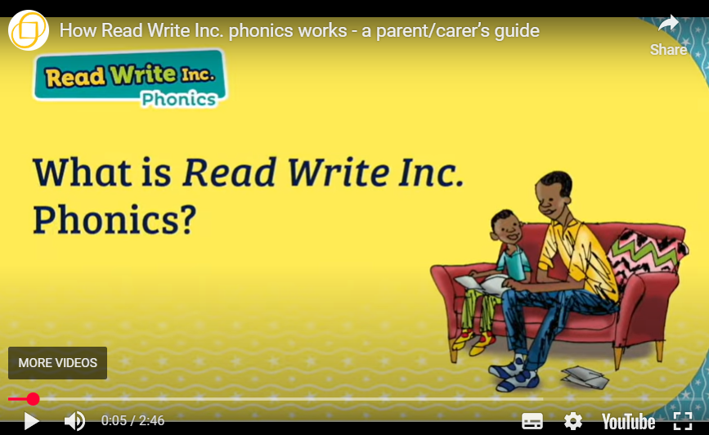
Phonic Scheme we use
The school scheme is – Ruth Miskin Read Write Ink (RWInc)

Slide 6
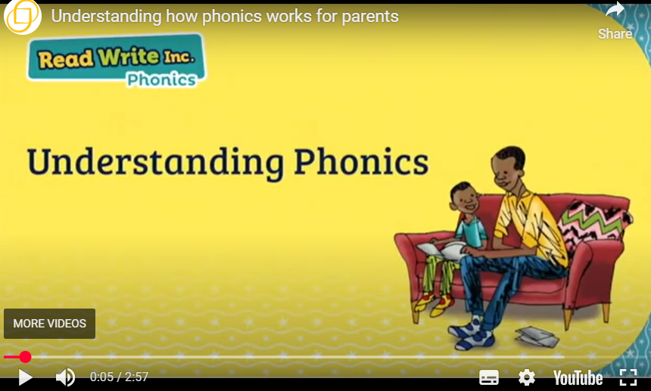
Why Phonics?
Why is it important to support your children with their Phonics.

Slide 7
Read Write Inc
Before your child can start to read, they need to learn how to –
Say the sound that is represented by each letter or groups of letters, these are called ‘Speed Sounds’.
Also how to blend the sounds together in a word to read it e.g. c-a-t = cat, this is called ‘Blending’.
We refer to this as ‘Fred Talk’.

Slide 8
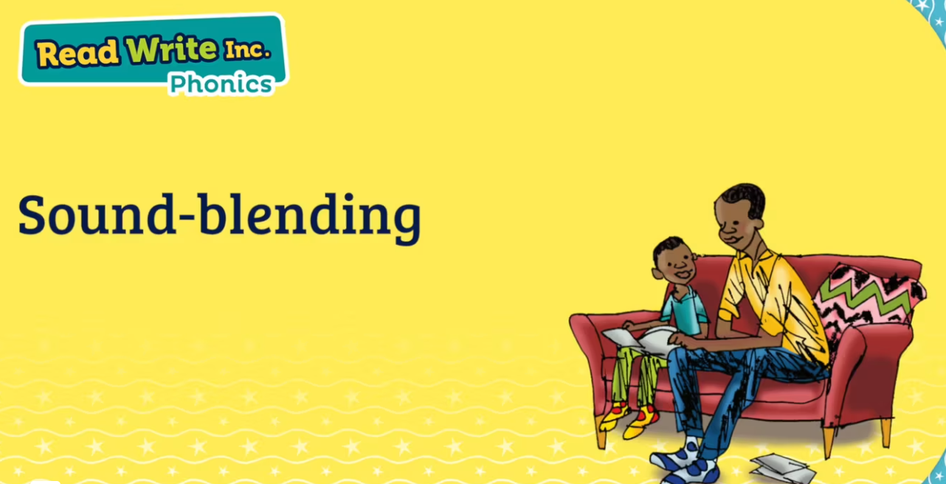
Sound Blending

Slide 9
Groupings
Children are assessed each half term on their knowledge of the sounds they have been taught and their ability to blend the sounds into words.
They are then grouped accordingly by their ability and taught in small groups across school. We currently have the children grouped into 11 groups, with 11 adults teaching phonics in the morning.
Phonics starts at 8:50am each morning.

Slide 10
How to help at home
Use pure sounds rather than letter names.
Use Fred Talk to help your child to read and spell words.
Listen to your child read their Storybook every day.
Read stories to your child every day.

Slide 11
How to help at home – Online Resources
Ruth Miskin Families Page:
https://www.ruthmiskin.com/parentsandcarers/
Ruth Miskin Facebook:
https://www.facebook.com/miskin.education
Free e-books for home reading:
http://www.oxfordowl.co.uk/Reading/

Slide 12


How to help at home
Parents and Carers Website -

Slide 13
Year 1 Phonic Screening
St Matthews CofE Aided Primary School
10th September 2025

Slide 14
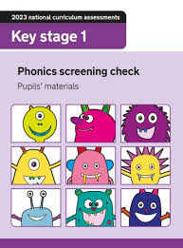
Year 1 Phonic Screening
Every child in Year 1 in the country will be taking part in the Phonics screening check in the same week in June.
The aim of the check is to ensure that all children can word read by the end of Year 2.
This ‘midpoint check’ will ensure that we have a clear understanding of what the children need to learn before entering Year 2.

Slide 15


What are the children expected to do?
The check is very similar to tasks the children already complete during phonic lessons.
Children will be asked to ‘sound out’ a word and blend the sounds together, e.g. d-o-g = dog
The focus of the check is to see which sounds thew children know and therefore the children will be asked to read made up ‘nonsense’ words. In school we refer to these words as alien words.

Slide 16
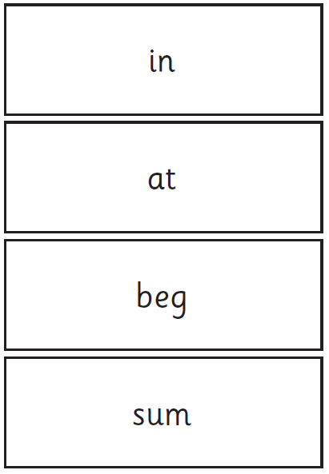
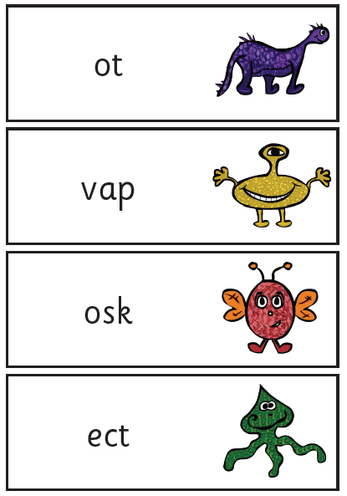
Examples of words

Slide 17

Phonic Screening 2026
The screening will take place throughout the week beginning Monday 8th June 2026. The children cannot take the test at any other point, so it is very important that your child is in school during this week.
The check has been designed so that children of all abilities will be able to take part.
The children will complete the check one at a time in a quiet area of the school and the check will be conduct by Mrs Urey who all the children are familiar working with.
The screening will only take around 10 minutes, but the children are under no obligation to complete it in any set amount of time.

Slide 18

How can you help
Children can practise their phonics by playing games online such as ‘Buried Treasure’ on the website Phonics Play.
Reading with your child daily.
Ask your child to read signs when you are out and about.
Also, encourage your child to –
Sound out words, re-read to check it makes sense, use pictures for clues.

Slide 19

Most important thing is that your child enjoys reading.

Slide 20
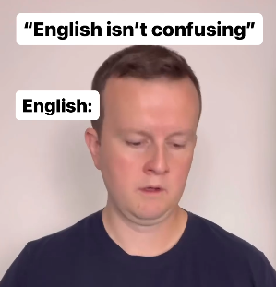
The English Language
Video ---- “English isn’t confusing”

Slide 21

If you have any questions or worries, please see myself or your child’s class teacher.
Thank you
Mrs Burns

