Slide 2
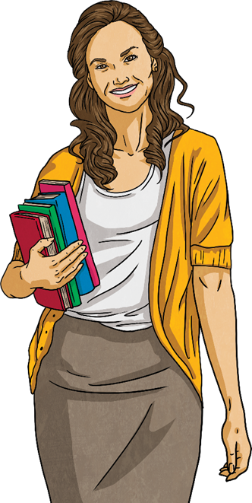
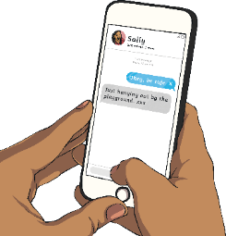
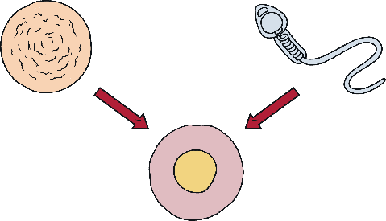
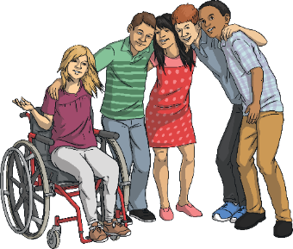
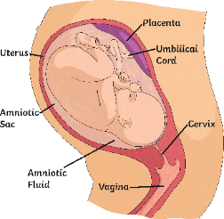
Aims of the Workshop
We hope that by the end of today’s workshop, you will:
have a clear understanding of our school’s approach to Relationships and Sex Education;
feel confident about what your child will be taught and how they will be taught;
have had your questions about Relationships and Sex Education adequately answered.

Slide 3
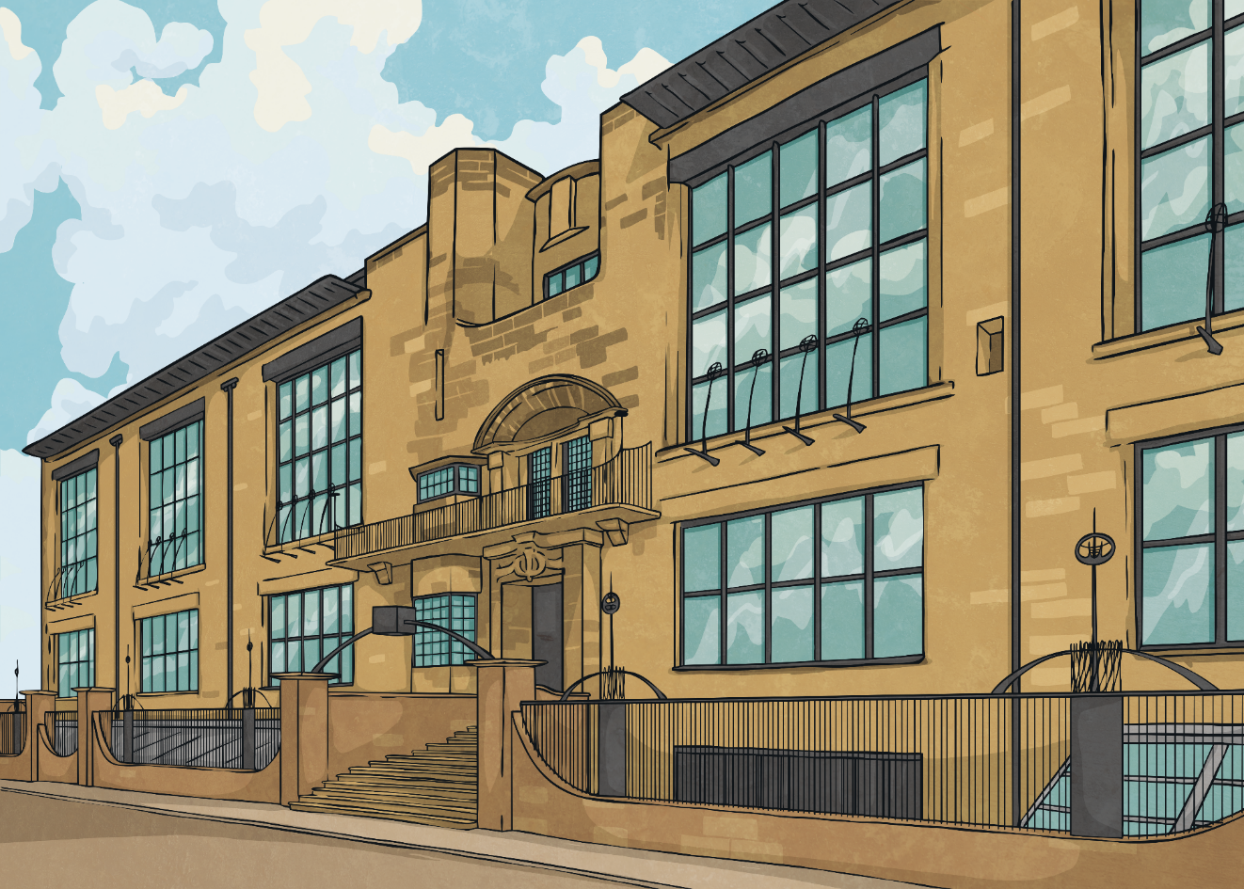
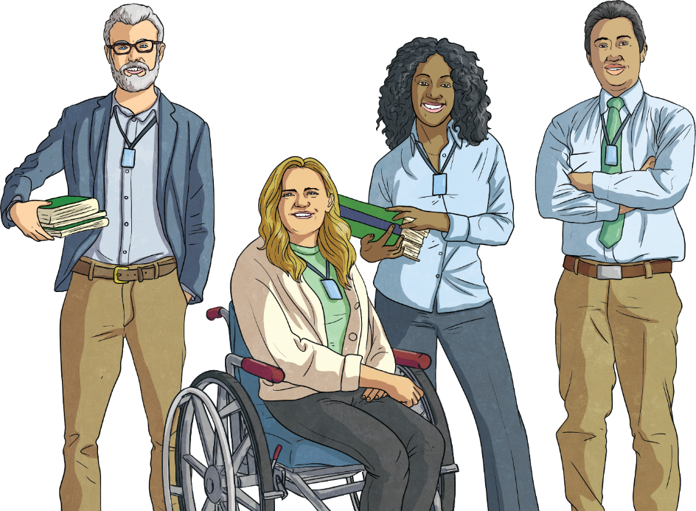
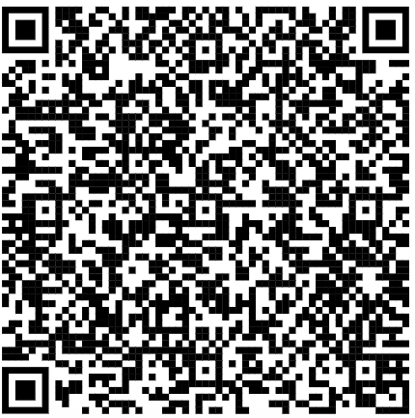
RSE in Our School
From September 2020, Relationships and Health Education became statutory for all primary school children.
Relationships and Sex Education (RSE) is an important part of our school curriculum.
QR code links to Government website – statutory guidance on RSE.
This means that all children have access to relevant information and the opportunity to gain vital knowledge and skills linked to their personal, social, health and citizenship education (PSHCE).

Slide 4
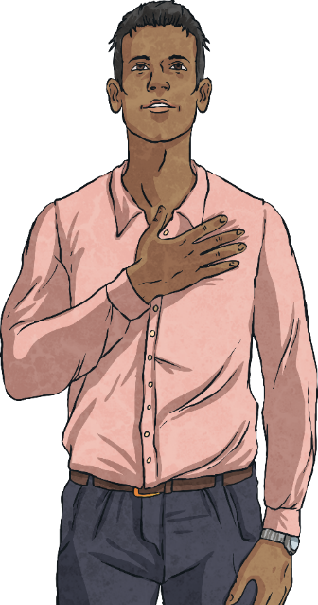
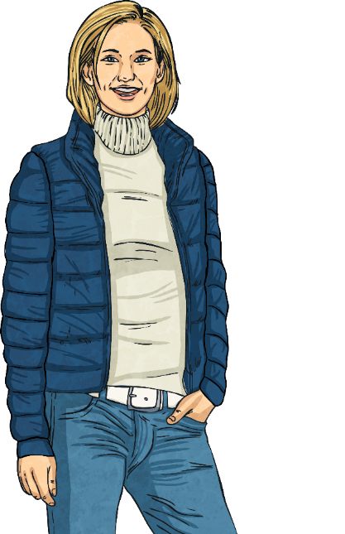
RSE in Our School
For an up-to-date Relationships and Sex Education Policy, you can visit our school website or request a paper copy. This is reviewed on a yearly basis.
The people responsible for Relationships and Sex Education in our school is:
Mrs D Mills and Mrs J Barfield

Slide 5
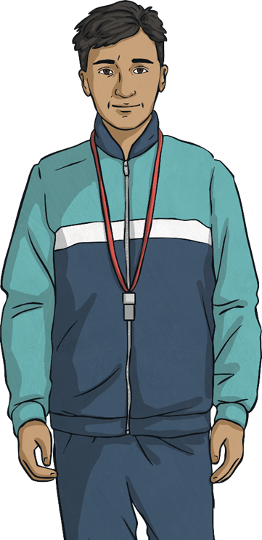
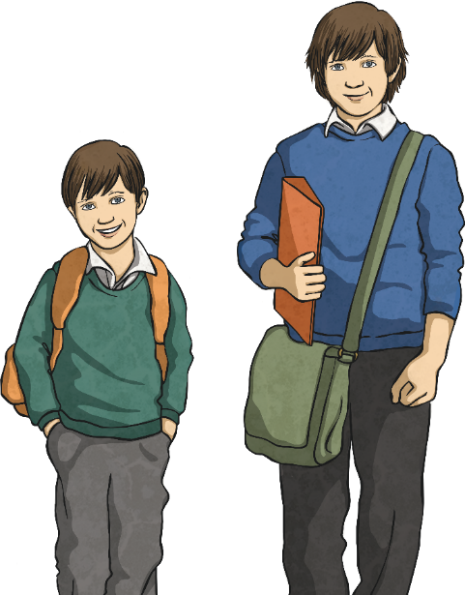
RSE in Our School
In our school, we offer high-quality teaching, covering all the compulsory objectives set out by the government, in a safe environment, through engaging, age-appropriate lessons and resources.

Slide 6
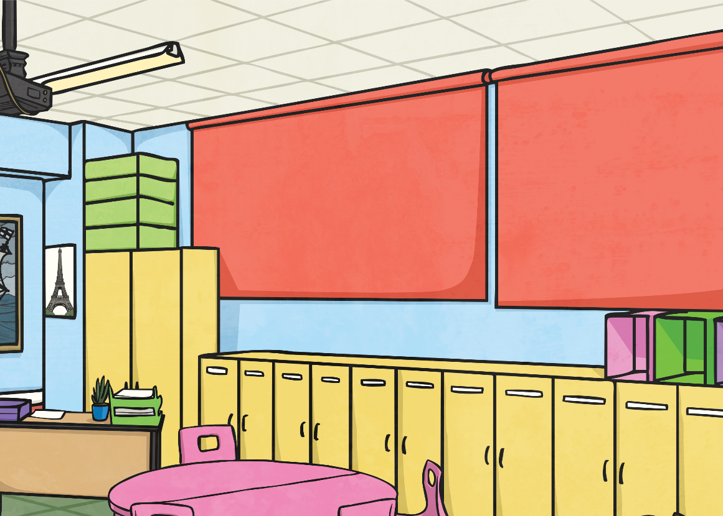
High-Quality Teaching
Like any area of the curriculum, you can expect teachers to have accurate, up-to-date knowledge on the content they deliver in class.
All the teaching staff at our school have received training in RSE so that they feel confident in their subject knowledge and in how to teach it. Class teachers will deliver the RSE part of the PSHE curriculum. HLTAs may deliver other parts of our PSHE curriculum.

Slide 7
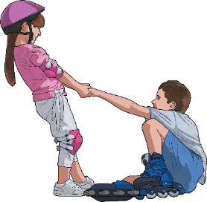
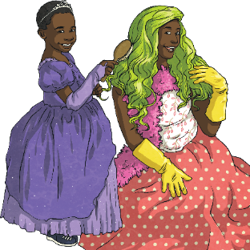
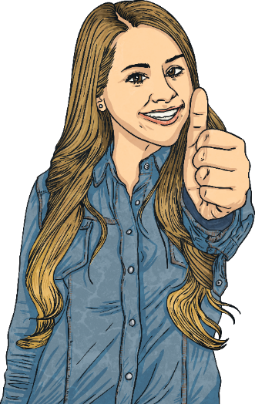
Compulsory Objectives
In primary school, the compulsory objectives are split into the following categories:
families and people who care for me
caring friendships
respectful relationships
online relationships
being safe

Slide 8
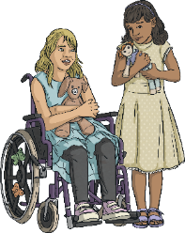
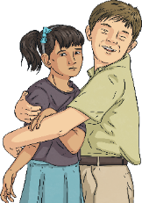
Compulsory Objectives
We believe that it is vital to start educating children about positive relationships and the part they play in our lives from a young age.
Children should learn how to take turns; how to treat others with kindness, consideration and respect; the importance of honesty and seeking or giving permission and the concept of personal privacy.
It is important that children learn about personal space and boundaries as well as respect for others. These are forerunners to teaching children about consent later on.

Slide 9
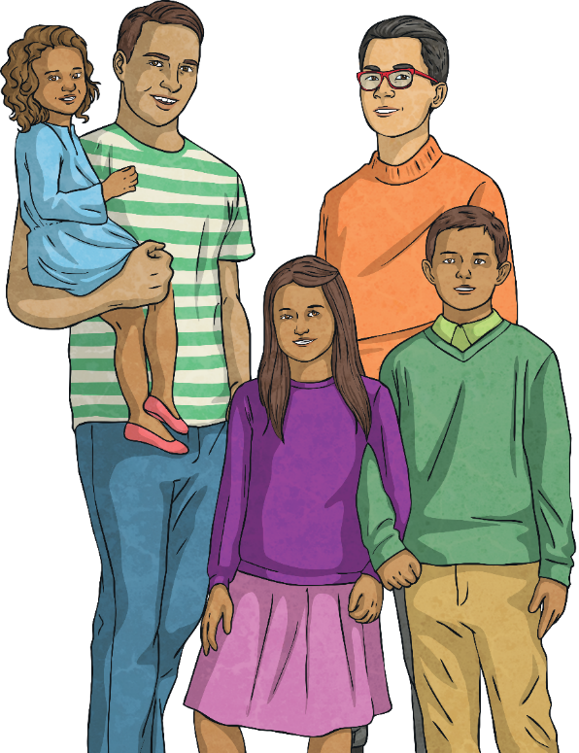
Compulsory Objectives
When learning about families, it is important that children are aware that families all look different. The government guidance states:
Teaching about families requires sensitive and well-judged teaching based on knowledge of pupils and their circumstances. Families of many forms provide a nurturing environment for children. (Families can include for example, single parent families, LGBT parents, families headed by grandparents, adoptive parents, foster parents/carers amongst other structures.) Care needs to be taken to ensure that there is no stigmatisation of children based on their home circumstances and needs, to reflect sensitively that some children may have a different structure of support around them; e.g. looked after children or young carers.

Slide 10
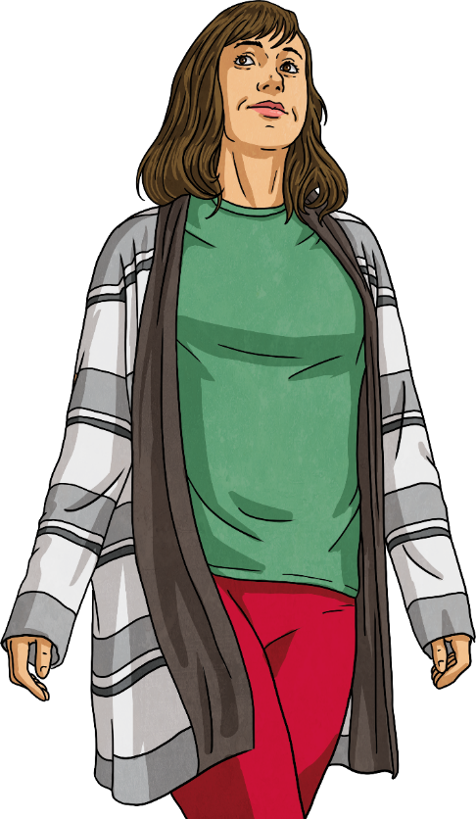
Compulsory Objectives
A common concern many parents and carers have is around Sex Education. We would like to reassure you that our curriculum covers this content in a sensitive, age-appropriate manner.
Our Relationships and Sex Education curriculum also complements the statutory objectives covered in national curriculum science.
At key stages 1 and 2, the national curriculum for science includes teaching about the main external parts of the body and changes to the human body as it grows from birth to old age, including puberty.

Slide 11
Compulsory Objectives
We encourage children to learn the names for their body parts in key stage 1. The earlier children use the correct terminology, the less uncomfortable they feel hearing or using these words as they get older.
We also believe, as the guidance from the Department for Education states, that children should have ‘the vocabulary and confidence’ to ‘report concerns or abuse’.
The government strongly recommends that all primary schools have a programme of Sex Education that includes preparing pupils for the changes adolescence brings and learning how a baby is conceived and born.

Slide 12
Compulsory Objectives
The government guidance states that all children, including those who develop earlier than the average, need to know about puberty before they experience the onset of physical changes. For this reason, lessons relating to puberty are compulsory.
In year 4, children will learn about the changes their bodies go through during puberty. We strongly believe that children need to know about these changes before they happen.
Learning about puberty now falls under statutory Health Education.

Slide 13
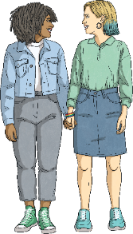
Compulsory Objectives
Using high-quality, up-to-date resources, we teach children in year 6, how a baby is conceived through a sexual relationship.
All aspects of our Relationships curriculum are statutory, but these Sex Education objectives are not and, as such, parents and carers do have the right to request that their child is withdrawn from certain lessons.
Please speak to us if you have any concerns or would like to know more about this.

Slide 14
Safe Environment
Of course, school should always be a safe environment. What we mean in this context however is that children should feel safe to discuss, learn about and ask questions about potentially sensitive topics.
To ensure this happens, we use certain techniques and resources:
Ground rules. These are established at the start of an RSE lesson so children know what is expected of them.
Displays and word banks. Children need the tools for learning about RSE and that includes knowing the correct vocabulary, so this is shared in the lesson.
Question Box. Each classroom has a Question Box, which children are encouraged to use for asking questions privately or anonymously. Teaching staff can then answer them appropriately at a convenient time.
Confidence and respecting privacy. Children will be told when information is private, how to discuss issues without making them personal or mentioning names of real people and that they can ask questions or discuss issues confidentially (unless a member of staff is concerned they are in some sort of danger).

Slide 15
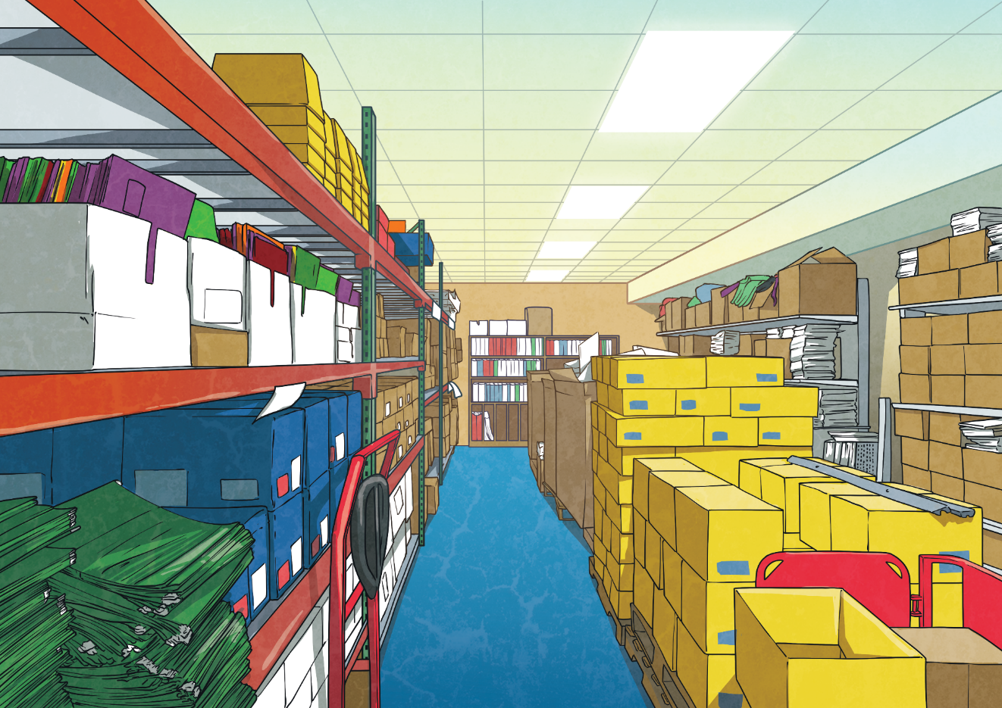
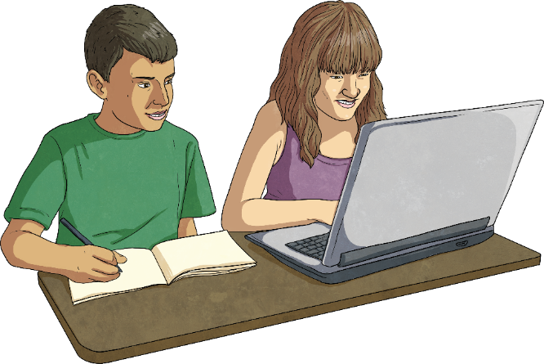
Lessons and Resources
We use a range of engaging resources and teaching methods in our lessons to teach children all about relationships. As a school we are using the Jigsaw curriculum to teach RSE and will supplement this with resources from Twinkl.
This might include picture and story books, poems, songs, art, drama, debates and discussions, photos, videos, presentations and activity sheets.
Sometimes, RSE objectives have cross-curricular links, such as with science or computing, so they may be covered as part of other areas of the curriculum.

Slide 16
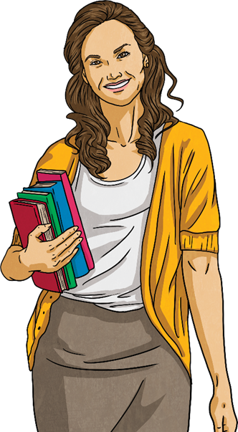
Pupil Voice
We are always keen to ensure our children have some input in their learning and as such, we endeavour to tailor our RSE curriculum to our pupils’ needs.
Through surveys and discussions with children, we are able to find out what they would like to know more about in their RSE lessons and how they feel about their learning.

Slide 17
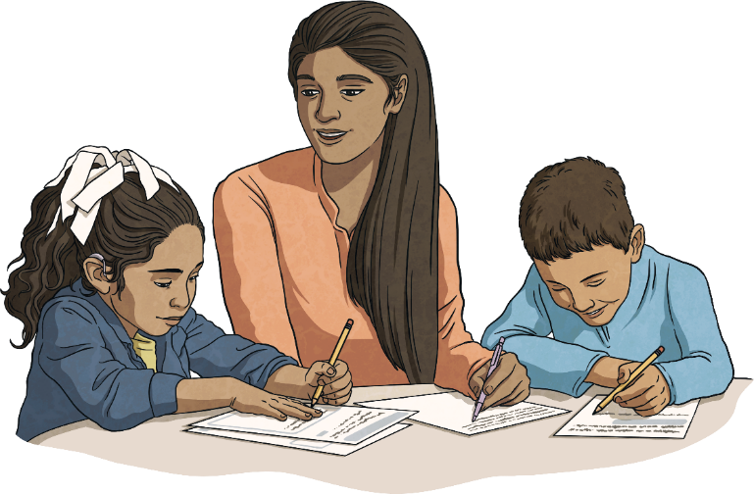
Working in Partnership with You
As with all aspects of your child’s education, a strong partnership between school and home is paramount.
We aim to share information about RSE, answer any queries or concerns you may have, keep you up to date with any changes and offer support.
We have a range of documents here that we think you might find useful. You are welcome to take these away with you.

Slide 18
Thank you for attending today’s workshop. We hope you found it useful.
Please feel free to ask any questions now. If you would like to discuss anything after the session, you are welcome to come and chat or make an appointment for another time.
Please take a moment to complete an evaluation form before you leave. There is also space on the form for further comments, questions or suggestions you might have.

